Slide 1

Cloud Storage
Dr. Kun Tang
Amazon Web Service
Email: kuntang@amazon.com
Notes:
About me
PhD degree in computer science from Temple University, in 2017, Advisor Dr. He
IMPROVING THE PERFORMANCE AND ENERGY EFFICIENCY FOR POWER-CONSTRAINED HIGH PERFORMANCE COMPUTING
After graduation, I Joined Amazon working in cloud storage space.

Slide 2
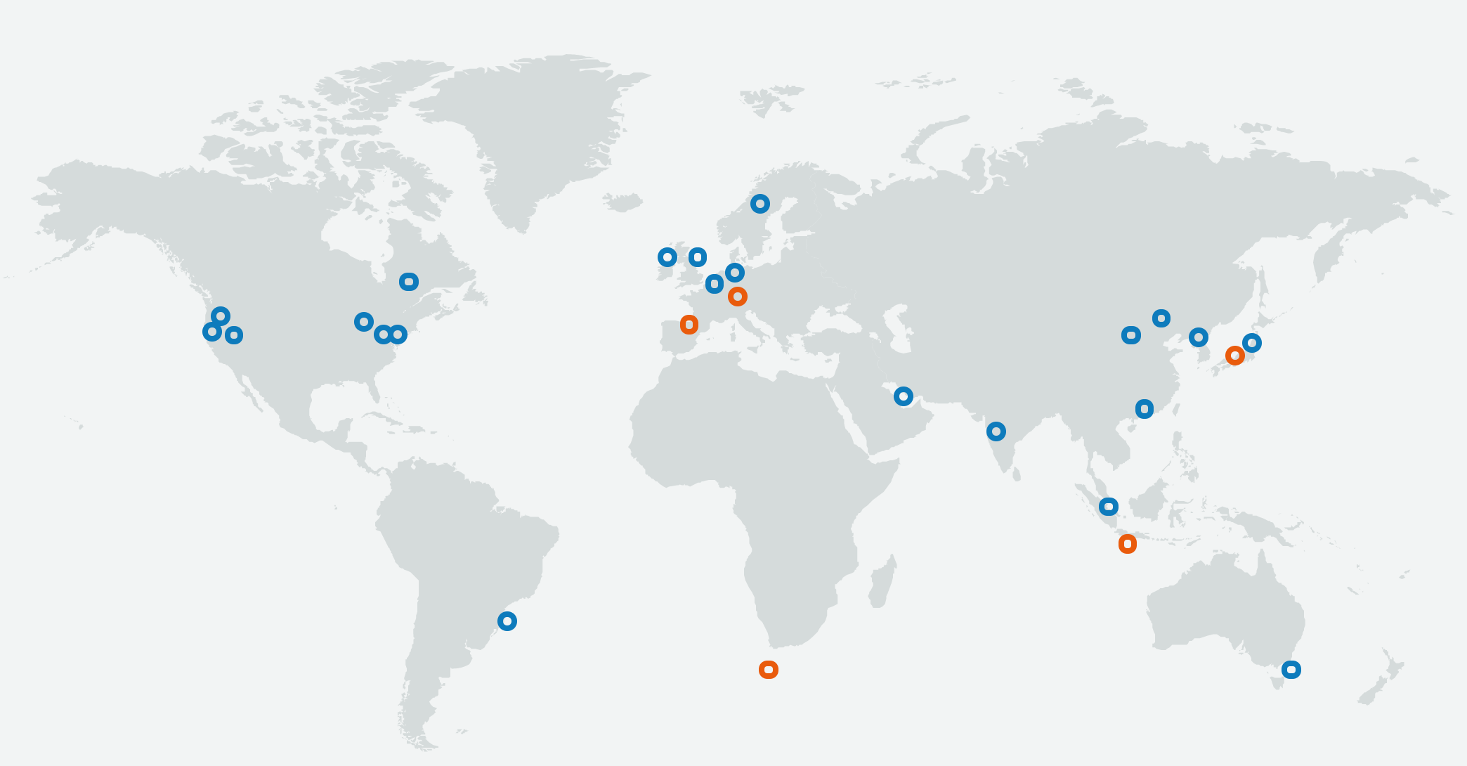
Year 2020
22 Regions
Notes:
Year 2020
22 Launched Regions
70 Availability Zones
5 Announced Regions

Slide 3
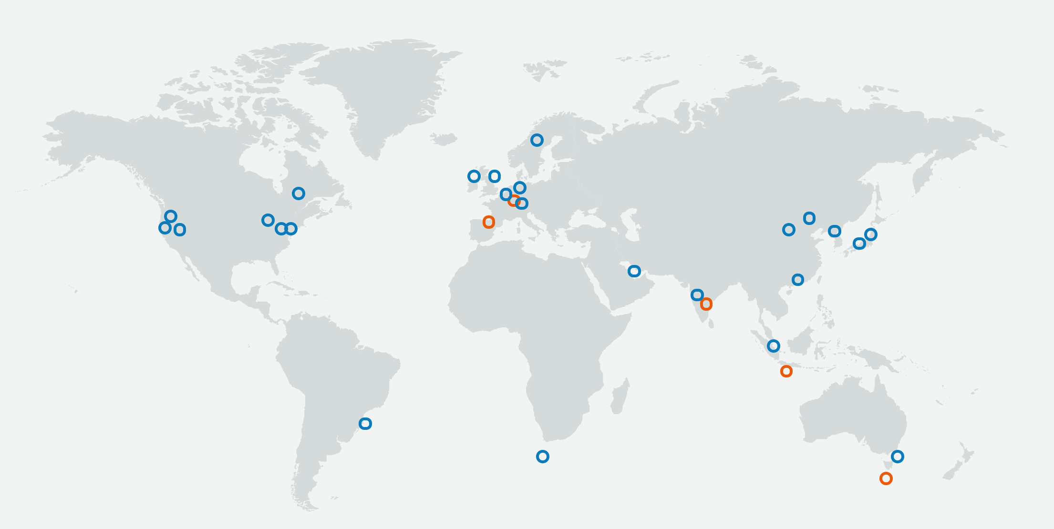
Year 2021
Milan
Switzerland
Osaka
Spain
Hyderabad
Jakarta
Cape Town
Melbourne
Notes:
Year 2021
25 Launched Regions
80 Availability Zones
5 Announced Regions
AWS has the concept of a Region, which is a physical location around the world where we cluster data centers. Each AWS Region consists of multiple, isolated, and physically separate AZ's within a geographic area. Each AZ has independent power, cooling, and physical security and is connected via redundant, ultra-low-latency networks.

Slide 4
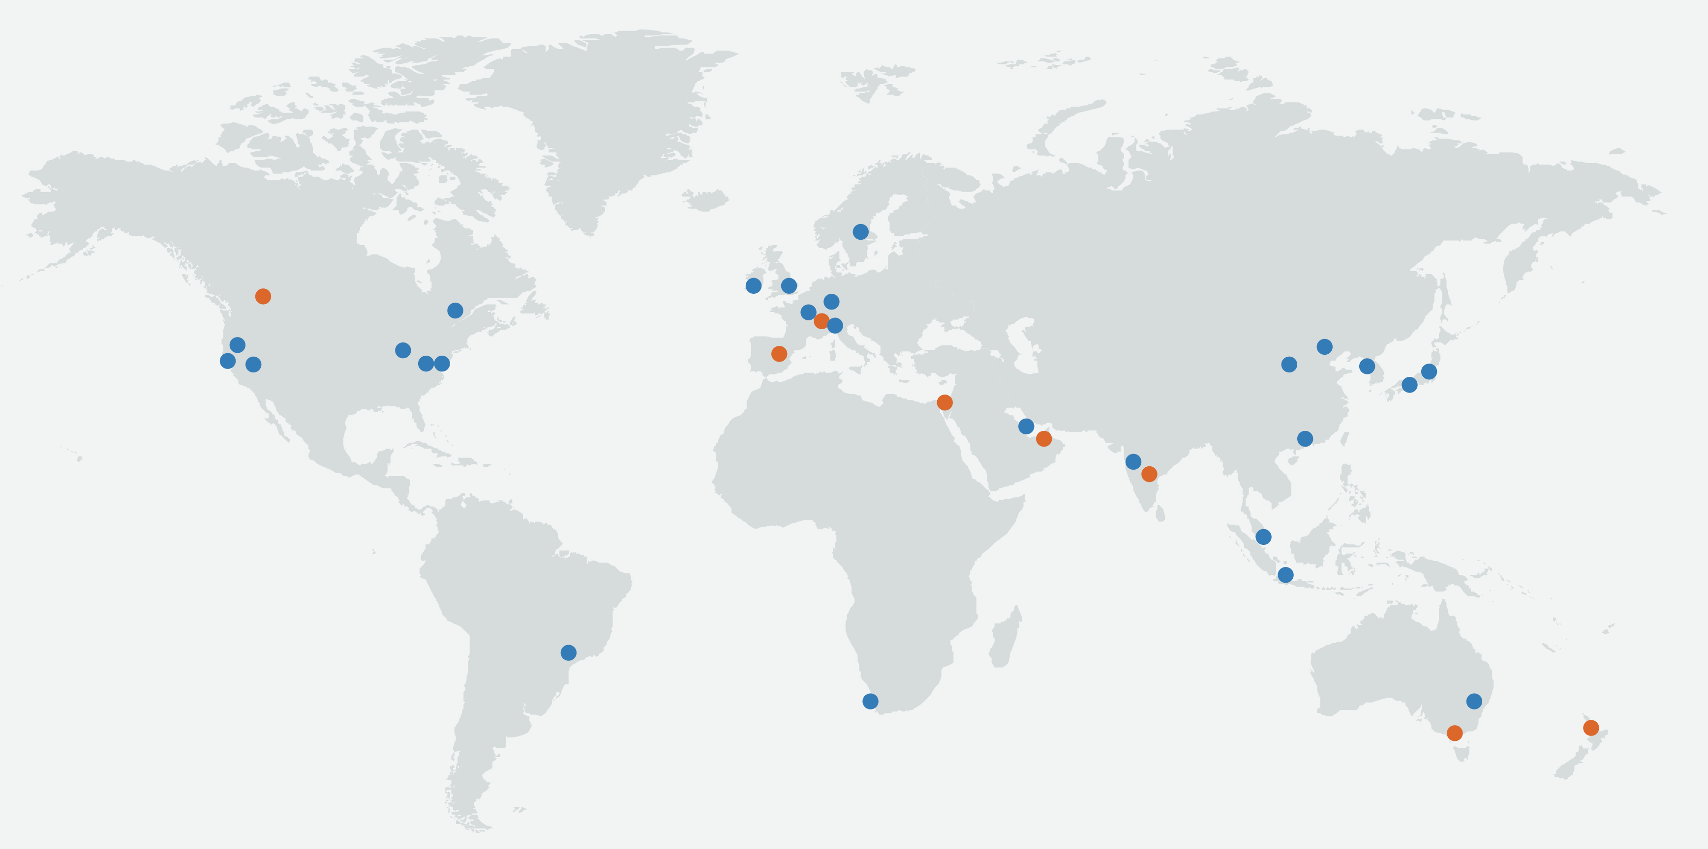
Year 2022
Canada
Switzerland
Spain
Israel
Hyderabad
United Arab Emirates
Jakarta
Auckland
Melbourne
Notes:
Year 2022
26 Launched Regions
84 Availability Zones
8 Announced Regions
AWS has the concept of a Region, which is a physical location around the world where we cluster data centers. Each AWS Region consists of multiple, isolated, and physically separate AZ's within a geographic area. Each AZ has independent power, cooling, and physical security and is connected via redundant, ultra-low-latency networks.

Slide 5
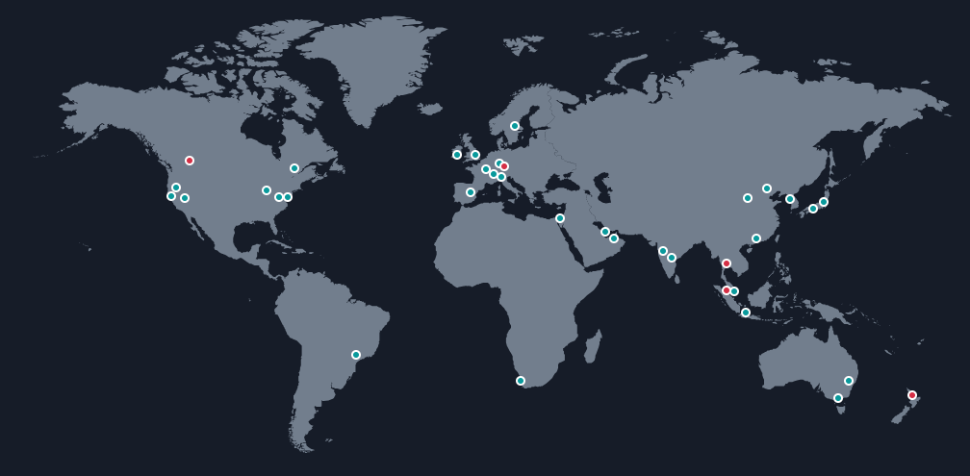
Year 2023
Canada
Germany
Switzerland
Thailand
Spain
Israel
Hyderabad
United Arab Emirates
Malaysia
Auckland
Melbourne
Notes:
Year 2023
32 Launched Regions
102 Availability Zones
5 Announced Regions
AWS has the concept of a Region, which is a physical location around the world where we cluster data centers. Each AWS Region consists of multiple, isolated, and physically separate AZ's within a geographic area. Each AZ has independent power, cooling, and physical security and is connected via redundant, ultra-low-latency networks.

Slide 6
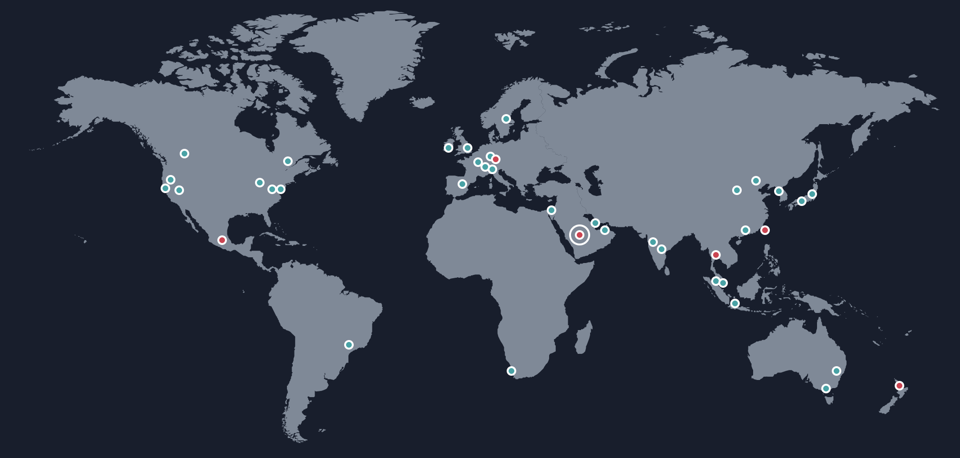
Year 2024
Germany
Thailand
Taiwan
Mexico
Kingdom of Saudi Arabia
Malaysia
Auckland
34 Regions
Notes:
Year 2023
32 Launched Regions
102 Availability Zones
5 Announced Regions
AWS has the concept of a Region, which is a physical location around the world where we cluster data centers. Each AWS Region consists of multiple, isolated, and physically separate AZ's within a geographic area. Each AZ has independent power, cooling, and physical security and is connected via redundant, ultra-low-latency networks.

Slide 7
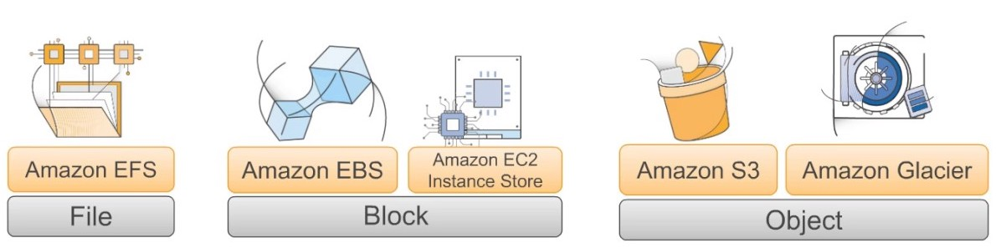
AWS Block, File, and Object Storage
Notes:
Amazon EFS is a file storage service for use with Amazon compute (EC2, containers, serverless) and on-premises servers. EFS provides a file system interface, file system access semantics (such as strong consistency and file locking), and concurrently accessible storage for up to thousands of EC2 instances.
Amazon Elastic Block Store (EBS) is a block-level storage service for use with EC2. Amazon EBS can deliver performance for workloads that require the lowest-latency access to data from a single EC2 instance.
Amazon Simple Storage Service (S3) is an object storage service. Amazon S3 makes data available through an internet API that can be accessed anywhere.

Slide 8
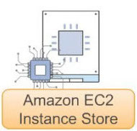
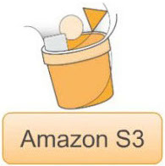
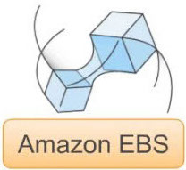
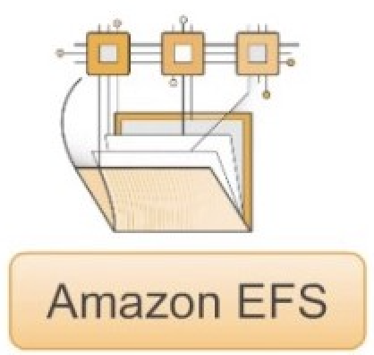

AWS Block, File, and Object Storage
Notes:
AWS Snowmobile is an Exabyte-scale data transfer service used to move extremely large amounts of data to AWS. You can transfer up to 100PB per Snowmobile, a 45-foot long ruggedized shipping container, pulled by a semi-trailer truck.
Even with high-speed internet connections, it can take decades to transfer extremely large amounts of data. With Snowmobile, you can move 100 petabytes of data in as little as a few weeks, plus transport time. That same transfer could take more than 20 years to accomplish over a direct connect line with a 1Gbps connection.

Slide 9
Amazon Glacier
Highly affordable long-term storage classes that can replace tape for archive and regulatory compliance.
Durability: 99.999999999% (11 9’s)
Availability
Expedited: 1-5 min
Standard: 3-5 hours
Bulk: 5-12 hours
Notes:
shingled magnetic recording HD
optical disk
tape

Slide 10
Amazon Simple Storage Service (Amazon S3)
A scalable, durable platform to make data accessible from any Internet location, for user-generated content, active archive, serverless computing, Big Data storage or backup and recovery
Durability: 99.999999999% (11 9’s)
Availability: 99.99%
Notes:
S3 is like dropbox, which is object storage.
We need block storage to build FS and run OS and applications. Much stricter requirements on performance, but lower requirement on durability.
What does the 9 mean

Slide 11
Amazon Elastic File System
Provides a simple, serverless, set-and-forget elastic file system that makes it easy to set up, scale, and cost-optimize file storage in AWS.
Durability: 99.999999999% (11 9’s)
Availability: 99.99%

Slide 12
Amazon Elastic Block Store
Provides highly available, consistent, low-latency block storage for Amazon EC2. It helps you tune applications with the right storage capacity, performance and cost.
Durability: 99.9% (2020)
Durability: 99.999% (2021)
Availability: 99.999%
Performance
Latency
IOPS
Throughput

Slide 13
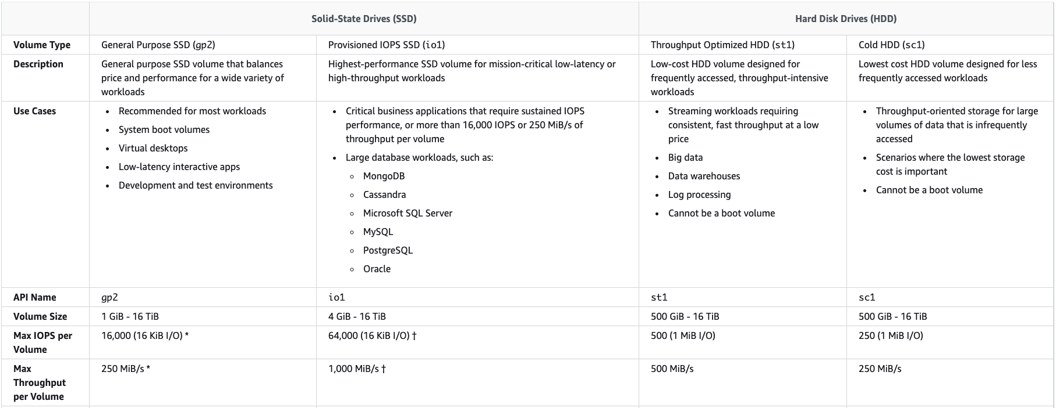
Amazon Elastic Block Store
Year 2020

Slide 14
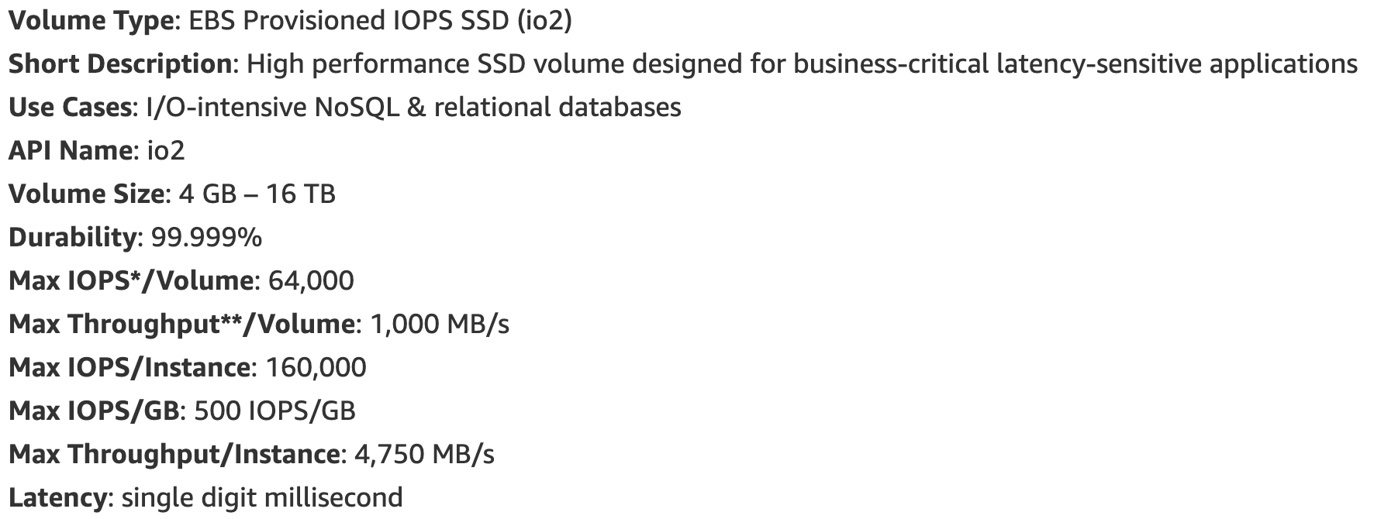
Amazon Elastic Block Store
Year 2021

Slide 15
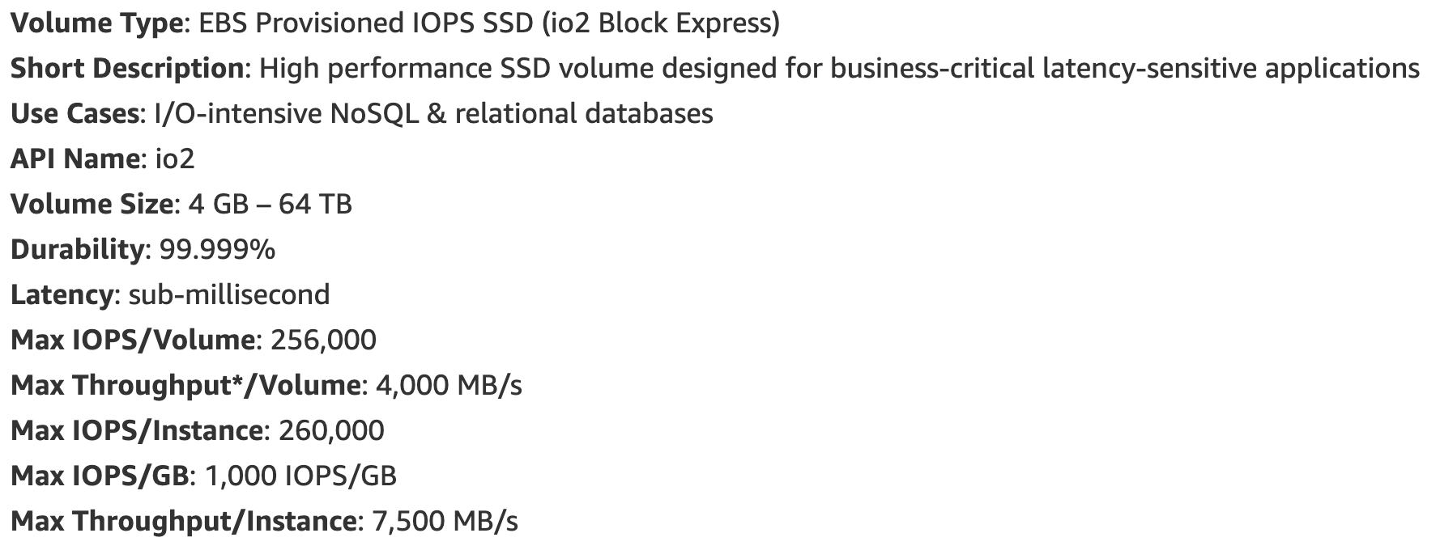
Amazon Elastic Block Store
Year 2021
Notes:
4x iops and throughput

Slide 16
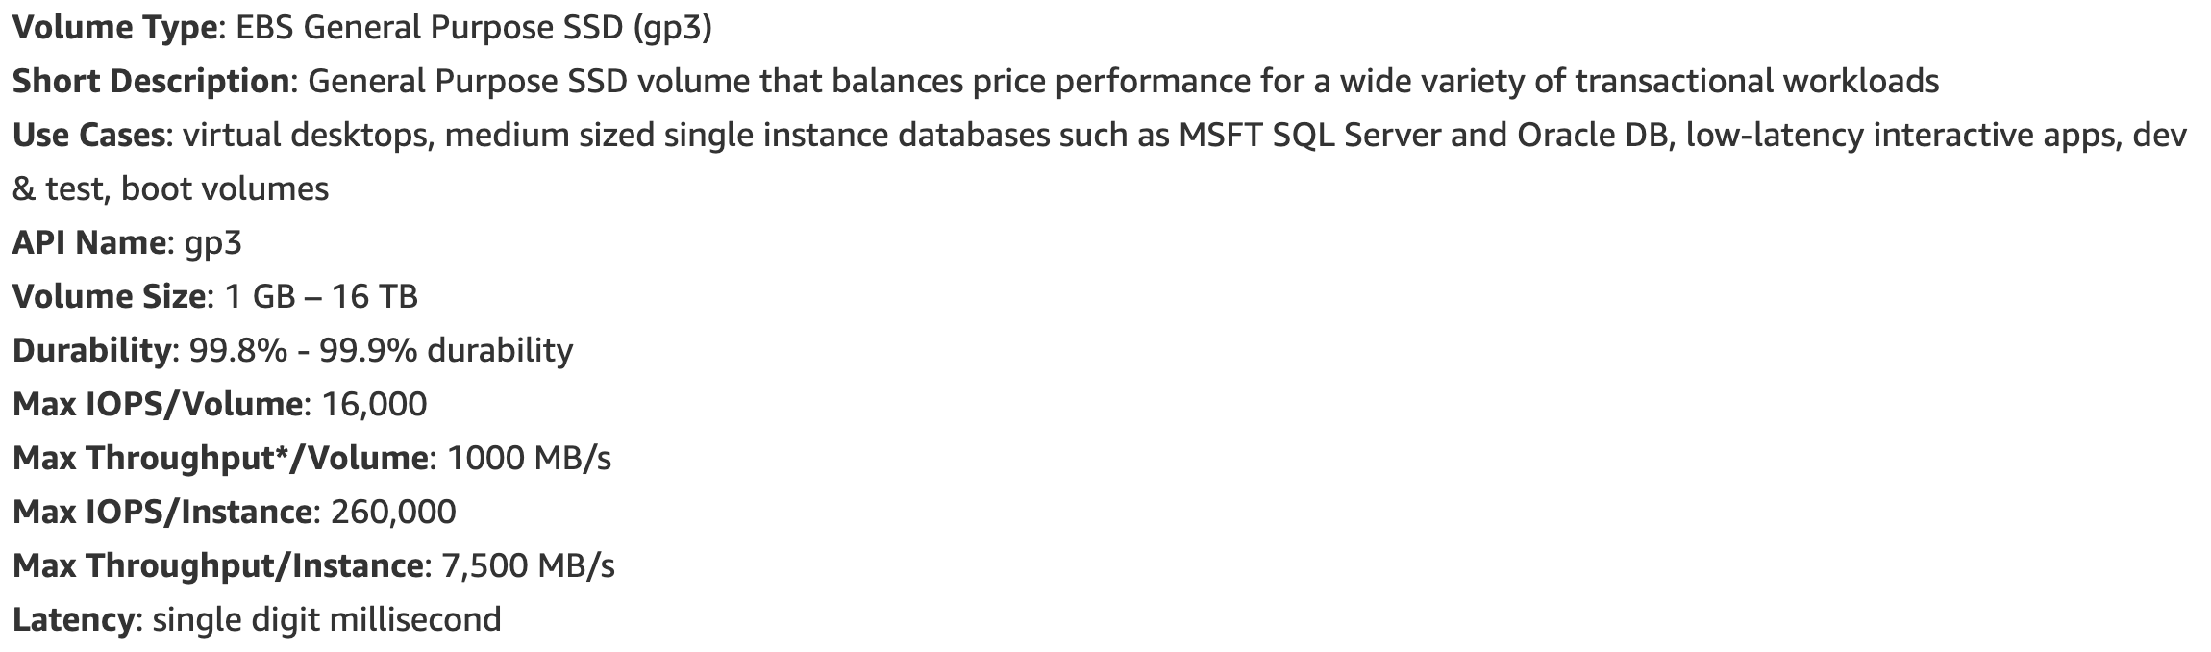
Amazon Elastic Block Store
Year 2021
Notes:
Next generation gp3 volumes offer the ability to independently provision IOPS and throughput, separate from storage capacity. This enables customers to scale performance for transaction-intensive workloads without needing to provision more capacity, so they only pay for the resources they need.
4x increase in max throughput per volume

Slide 17
Availability
Availability refers to system uptime, i.e. the storage system is operational and can deliver data upon request. Historically, this has been achieved through hardware redundancy so that if any component fails, access to data will prevail.
Will running more volumes lower the average downtime per volume?
Volume year: time in volumes’ perspective
1 volume running for 1 year equals to 2 volumes running for 0.5 year
 | Amazon S3/EFS | Amazon EBS
Availability | 99.99% | 99.999%
Downtime | 52.6 minutes per year | 5.25 minutes per year

Slide 18
Durability
Durability, on the other hand, refers to long-term data protection, i.e. the stored data does not suffer from bit rot, degradation or other corruption. Rather than focusing on hardware redundancy, it is concerned with data redundancy so that data is never lost or compromised.
Annualized failure rate (AFR) gives the estimated probability that a device or component will fail during a full year of use.
 | Amazon S3/EFS | Amazon EBS
Durability | 99.999999999% | 99.999%
AFR | 0.000000001% | 0.001%
AFR = 1 – exp( -8766 / MTBF)
Notes:
This equation assumes that the device or component is powered on for the full 8766 hours of a year. It is based on an exponential failure distribution.

Slide 19
Durability
What are failures like at large scale?
Seagate Barracuda ES.2 HDD: “The product shall achieve an Annualized Failure Rate - AFR - of 0.73% (Mean Time Between Failures - MTBF - of 1.2 Million hours).”
If a storage server has 10 HDDs, MTBF per server is 120 thousand hours.
If a data center has 100,000 storage servers, we can expect one host failure every 1.2 hour.
Failures are common
Hard drive
Network (NIC, Switch, etc)
PSU
Mother-board
Memory Chips
Software
Fault Tolerant Distributed Systems

Slide 20
Durability vs Availability
Why durability decreases as availability increases?
 | Amazon S3/EFS | Amazon EBS
Availability | 99.99% | 99.999%
Durability | 99.999999999% | 99.999%
Notes:
Is this a AWS limit?

Slide 21
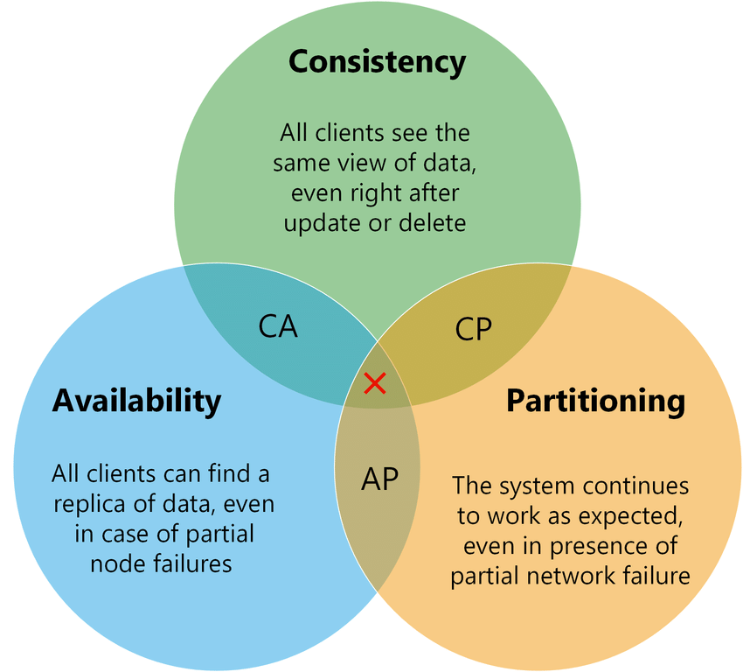
CAP Theorem ^{[1]}
[1] Seth Gilbert and Nancy Lynch. 2002. Brewer’s conjecture and the feasibility of consistent, available, partition-tolerant web services. SIGACT News 33, 2 (June 2002), 51–59.
Notes:
The CAP theorem is also called Brewer’s Theorem, because it was first advanced by Professor Eric A. Brewer during a talk he gave on distributed computing in 2000. Two years later, MIT professors Seth Gilbert and Nancy Lynch published a proof of “Brewer’s Conjecture.”

Slide 22
CAP Theorem ^{[1]}
S1
S1
S2
X
S3
S2
S3
X
write
write
Consistency
Availability
[1] Seth Gilbert and Nancy Lynch. 2002. Brewer’s conjecture and the feasibility of consistent, available, partition-tolerant web services. SIGACT News 33, 2 (June 2002), 51–59.
Notes:
Which one to write?
How to determine write is successful?
Which one to read?

Slide 23
Problems
When to fail write?
When to fail read?
Which server has the latest write?
S1
S1
S2
X
S3
S2
S3
X
write
write
Consistency
Availability
[1] Seth Gilbert and Nancy Lynch. 2002. Brewer’s conjecture and the feasibility of consistent, available, partition-tolerant web services. SIGACT News 33, 2 (June 2002), 51–59.
Notes:
In order to achieve high availability and durability, we need to have multiple copies of the same data, so that when hw/sw failure happens, it can still return the data in time.
A fundamental problem in distributed computing and multi-agent systems is to achieve overall system reliability in the presence of a number of faulty processes. This often requires coordinating processes to reach consensus, or agree on some data value that is needed during computation.
Minority of servers fail: no problem
Majority fail: lose availability, retain consistency

Slide 24
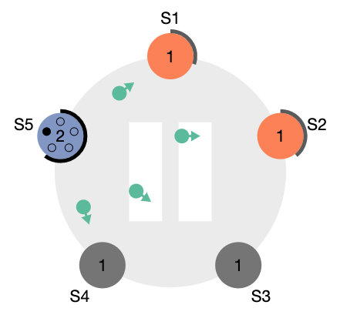
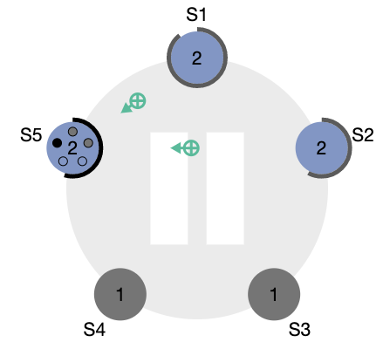
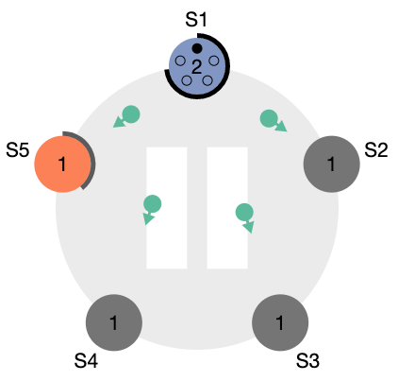
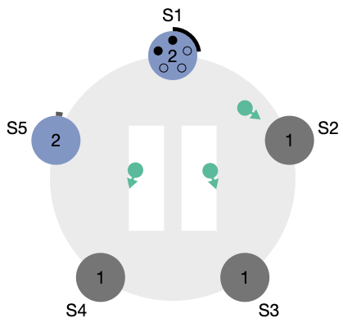
Quorum Consensus Algorithms
Consensus is a fundamental problem in fault-tolerant distributed systems. Consensus involves multiple servers agreeing on values. Once they reach a decision on a value, that decision is final. Typical consensus algorithms make progress when any majority of their servers is available; for example, a cluster of 5 servers can continue to operate even if 2 servers fail. If more servers fail, they stop making progress (but will never return an incorrect result).
2 servers fail
3 servers fail
Notes:
In order to achieve high availability and durability, we need to have multiple copies of the same data, so that when hw/sw failure happens, it can still return the data in time.
Minority of servers fail: no problem
Majority fail: lose availability, retain consistency

Slide 25
Quorum Consensus Algorithms
Paxos^{[2]} and Paxos Made Simple^{[3]}
Raft^{[4]} is a consensus algorithm that is designed to be easy to understand. It's equivalent to Paxos in fault-tolerance and performance. The difference is that it's decomposed into relatively independent subproblems, and it cleanly addresses all major pieces needed for practical systems.
[2] Leslie Lamport. 1998. The part-time parliament. ACM Trans. Comput. Syst. 16, 2 (May 1998), 133–169.
[3] Leslie Lamport. 2001. Paxos Made Simple. ACM SIGACT News 32, 4 (December 2001), 51-58.
[4] Diego Ongaro and John Ousterhout. 2014. In search of an understandable consensus algorithm. In Proceedings of the 2014 USENIX conference on USENIX Annual Technical Conference (USENIX ATC’14).
Notes:
Leader selection
Performance
Availability

Slide 26
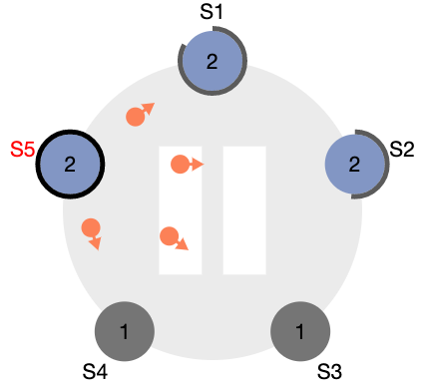
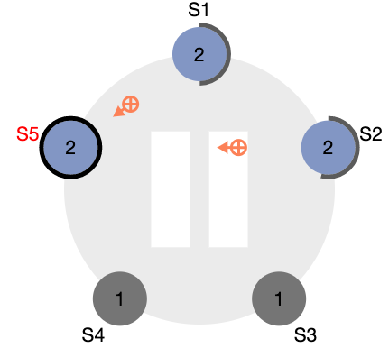
Quorum Consensus Example ^{[5]}
There are N replicas in a group.
Each replica stores the state for each item, plus an extra piece of information: a version number.
The idea is that if different replicas store different version numbers for an item, the state associated with a larger version number is more recent than the state associated with a smaller version number.
Leader Election
Replication
[5] http://web.mit.edu/6.033/2005/wwwdocs/quorum_note.html
Notes:
Phase 1: get data with highest version number
Phase 2: read data; write data and send update
Leader selection each IO? Or extended leadership?
per IO: higher availability (when a server is down, recover on next IO), low performance (leader selection each IO)
Extended leadership: lower availability (when a server is down, recover when timer expires), high performance (leader selection once in a while)

Slide 27
Quorum Consensus Example ^{[5]}
Reads go to a read quorum of size R and writes go to a write quorum of size W. Furthermore, we require that R+W > N, i.e., read quorums always intersect with write quorums. This will ensure that read results always reflect the result of the most recent write (because the read quorum will include at least one replica that was involved in the most recent write).
Leader Election
Replication
[5] http://web.mit.edu/6.033/2005/wwwdocs/quorum_note.html
Notes:
Read on 3 replicas
Write on 3 replicas
If W = 2, R = 3, write to S3 and S4, then read from S1, S2, and S5 does not return correct data

Slide 28
Quorum Consensus Example
For example, consider a group of 3 replicas. Then we have the following possibilities:
R=3 and W=1. This improves performance for writes at the expense of reads, which is probably a bad idea since generally reads are more common than writes. In addition, this choice of quorums is bad because a write might happen at a single replica that then fails. If that replica were to lose its state, the outcome of the write would be lost. So generally we would like to have W>1.
R=1 and W=3. This works very well for reads which is generally good since reads are common. But it is undesirable for writes because if one of the replicas is down or inaccessible, a write cannot complete until that replica recovers.
R=2 and W=2. This choice is a good compromise compared to the R=1 and W=3 choice, since it increases the cost of reads in return for providing reasonable availability for writes.
S1
S1
S1
S1
S2
S3
S2
S3
S2
S3
S2
S3
write
write
write
read

Slide 29
Quorum Consensus Example
For example, consider a group of 3 replicas. Then we have the following possibilities:
R=3 and W=1. This improves performance for writes at the expense of reads, which is probably a bad idea since generally reads are more common than writes. In addition, this choice of quorums is bad because a write might happen at a single replica that then fails. If that replica were to lose its state, the outcome of the write would be lost. So generally we would like to have W>1.
R=1 and W=3. This works very well for reads which is generally good since reads are common. But it is undesirable for writes because if one of the replicas is down or inaccessible, a write cannot complete until that replica recovers.
R=2 and W=2. This choice is a good compromise compared to the R=1 and W=3 choice, since it increases the cost of reads in return for providing reasonable availability for writes.
S1
S1
S1
S1
S2
S3
S2
S3
S2
S3
S2
S3
write
read
read
read

Slide 30
Quorum Consensus Example
For example, consider a group of 3 replicas. Then we have the following possibilities:
R=3 and W=1. This improves performance for writes at the expense of reads, which is probably a bad idea since generally reads are more common than writes. In addition, this choice of quorums is bad because a write might happen at a single replica that then fails. If that replica were to lose its state, the outcome of the write would be lost. So generally we would like to have W>1.
R=1 and W=3. This works very well for reads which is generally good since reads are common. But it is undesirable for writes because if one of the replicas is down or inaccessible, a write cannot complete until that replica recovers.
R=2 and W=2. This choice is a good compromise compared to the R=1 and W=3 choice, since it increases the cost of reads in return for providing reasonable availability for writes.
S1
S1
S1
S1
S2
S3
S2
S3
S2
S3
S2
S3
write
read
read
read
Notes:
Now we learned the fundamentals of quorum consensus algorithm. When building a system using the quorum consensus algorithm, you will try to come up with a comprehensive list of test inputs and find out some edge cases not getting handled properly. Have you thought about the question: how comprehensive can the list of inputs become so that we cover all edge cases? It’s easy to do the happy path, but takes more efforts to get every edge case right.

Slide 31
Cloud Storage
Dr. Kun Tang
Amazon Web Service
Email: kuntang@amazon.com
Notes:
Contact me if you or your friends are interested to join AWS.

